Slide 1

INSTITUTE OF TECHNOLOGY
X LOCATION
DEPARTMENT OF ELECTRONICS AND COMMUNICATION ENGINEERING
Mini-Project Presentation On
“Brain tumour detection using image processing”
Submitted in Partial Fulfillment of the requirement of Mini Project[18ECMP68]
In
ELECTRONICS AND COMMUNICATION ENGINEERING.
Under the Guidance of:
XXXXXX
Assistant Professor. Dept. of E&C Engg,
MRIT.
Presented by:
Gaurav Kumar [4MU18EC000] XXXXXXXXX XXXXXXXX
7/12/2021
1

Slide 2
CONTENTS
ABSTRACT
INTRODUCTION
PROPOSED METHOD
MATLAB ADVANTAGE
EXPLAIN MRI
CONCLUSION
REFERENCES

Slide 3
ABSTRACT
Brain tumor detection and classification is that the most troublesome and tedious task within the space of medicative image getting ready.
Magnetic resonance imaging (MRI) may be a medicative procedure, typically adopted by the medical specialist for illustration of inner structure of the build with no surgery.
Magnetic resonance imaging provides long information concerning the human delicate tissue, that helps within the conclusion of brain tumor.
MRI paper is concentrated towards the look of Associate in Nursing best and additional correct approach for the detection of neoplasm from brain MRI scans and if it confirms the presence of tumor then it's focused on evaluating its stage, i.e., benign or malignant.
Keywords: Image Segmentation, Support Vector Machine, Self-Organiz

Slide 4
INTRODUCTION
This project proposes two different methodologies to segment a tumor from an MRI image and determine the type of tumor. For this one segmentation and one clustering techniques have been implemented.
Each MRI image is passed through an imaging chain where the image preprocessed to remove noise and is further enhanced to improve the contrast of the image.
MRI paper proposes two different techniques which are then applied on the image to extract the tumor.
MRI segmentation techniques include SOM Clustering and SVM Classification.
The tumor region represents the pixel values for the foreground points extracted using the input() command from a texture image. The texture image is generated by applying the rangefilt() method.

Slide 5
Also the unwanted noise and reduced contrast displays several regions from the image that are falsely claimed as a tumor.
Another challenge faced was degraded quality of the MRI image due to several problems that would have occurred during the acquisition stage.
In this project, the major challenge faced was to locate and extract the proper tumor region from the image. Due to several lighting issues, unnecessary white portions were present in the image which could wrongly be segmented as a tumor.

Slide 6
PROPOSED METHOD
In this Proposed Method are classified in 4 parts:
MRI of Brain Images
Pre-Processing
Images Enhancement and Filtering
Feature Extraction
Image Analysis

Slide 7
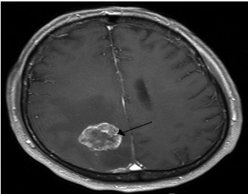
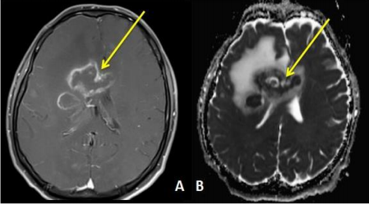
MRI OF BRAIN TUMORE
In this the data is been provided that is the magnetic resonance images(MRI) that are been collected in their original format’s that are (.ima, .dcm).
Mostly the mri images are of .dcm (DICOM[13]) Digital imaging and communications in medicine.
We have used file operations fopen(), fclose() available in matlab to read MRI images. Here the gray scale MRI images are been provided as input to the system

Slide 8
PRE-PROCESSING
Pre-processing phase of our project mainly involves those operations that are ordinarily essential before the goal analysis and extraction of the required data and ordinarily geometric corrections of the initial image.
This conversion of DICOM image to .jpeg is done by using function dicom2image()[7]. Major issues related to the preprocessing stage are as follows:-
a. Noise,
b. Blur Low Contrast
c. The bias
d. The partial-volume effect.

Slide 9
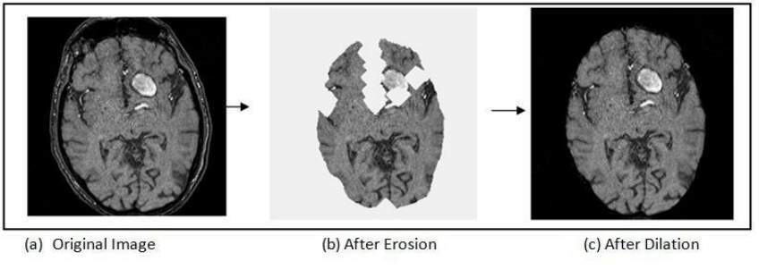
This pre-processing stage is used for reducing image noise, highlighting important portions, or displaying obvious portions of digital images.

Slide 10
IMAGE ENCHAMENT & FILTERING
The enhancement of the image starts by first converting the gray scale image to black and white image this is done by the use of function im2bw(gray_image)[7].
The threshold value taken in our project is 0.6.As Image improvement strategies improve the visual look of pictures from tomography and also the distinction enhancing brain volumes are linearly associated.
For image sharpening the imsharpen()[7] is been used,similiarly imadjust()[7] for image adjustment, freqz() for setting frequency response of image are been used.
The Gaussian smoothing operator is been for the two dimensional image convolution operators that is used to `blur' images and remove detail and noise
The colour spaces used in our image processing methods are Gray, Binary form and RGB.

Slide 11
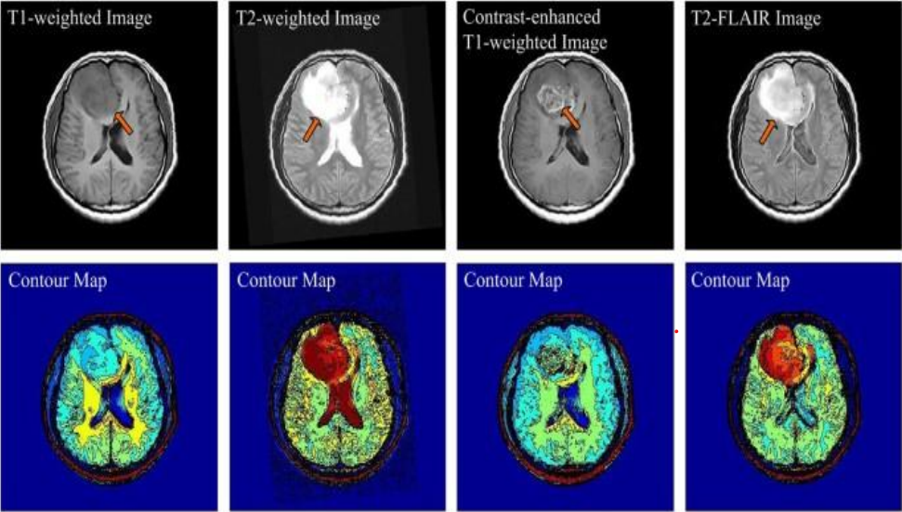
Color areas, which indicate the colors in an exceedingly benchmark approach by employing a reference frame and a topological space within which every color is delineated by one point of the coordinate system.

Slide 12
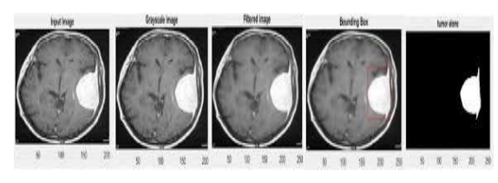
FEATURE EXTRACTION
In this phase the features of the given input image is been extracted .
These features include smoothness, entropy, variance, kutosis, skewness, idm, correlation, homogeneity, mean and standard deviation .
And on the basis of these features the image is analysed and the detection of the tumor region is been done.
Below in the figure there are output result of an MRI image uptill the feature extraction phase of the project.
(a)Input image, (b)Grayscale image, (c)Tumor alone image, (d)Tumor outline, (e)Detected tumor

Slide 13
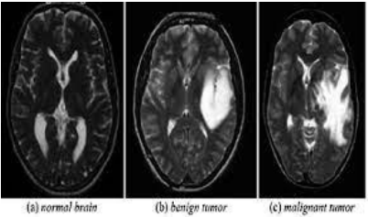
IMAGE ANALYSIS
After the type of tumor is been identified the image analysis is been done to determine the accuracy of the result.
Here in this project four type of accuracy are been shown that are Rbf accuracy, Linear accuracy, Polygonal accuracy and Quadratic accuracy.
These accuracies help in analysis of the image result.
Showing the result of the taken mri image and providing the classification of the type of tumor.

Slide 14
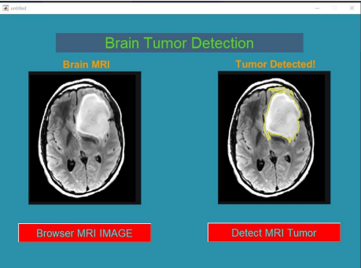
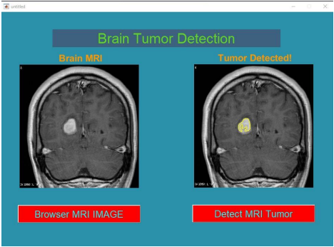
MATLAB USE IN Medical field
MATLAB has image and data processing capabilities, so can be used for analysis of medical imaging data, such as in nuclear medicine, CT, MRI and fluorescein angiogram images. UoB researchers have also used image analysis on microscope and other types of images to detect disease such as brain tumore cancer & etc…

Slide 15
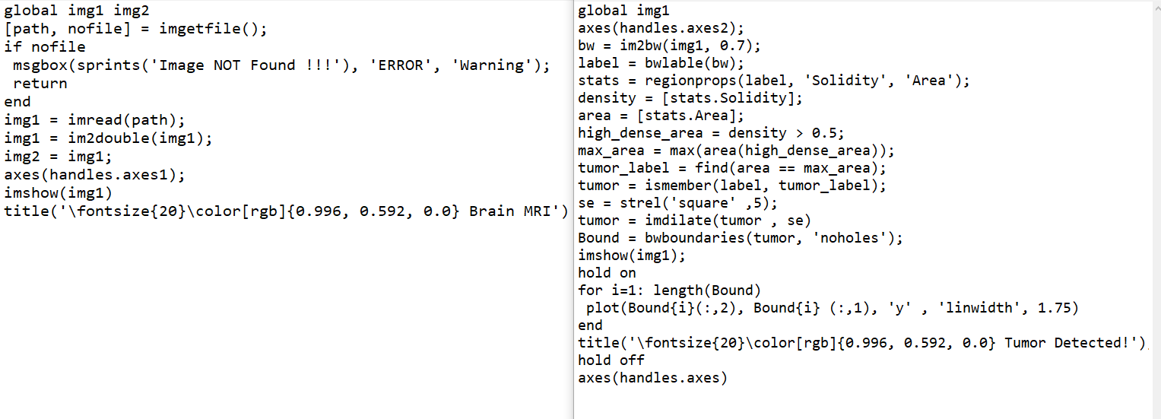
MATLAB CODE

Slide 16
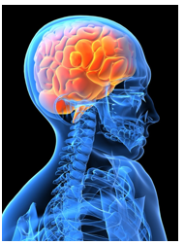
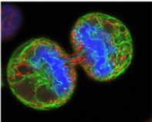
1. WHAT IS BRAIN TUMOUR?
Uncontrolled and abnormal cell growth in the brain is called a brain tumour. The space in our skull is restricted. Therefore, this extra growth inside our brain causes more pressure inside the skull, causing life-threatening complications, and also damaging our brain.

Slide 17
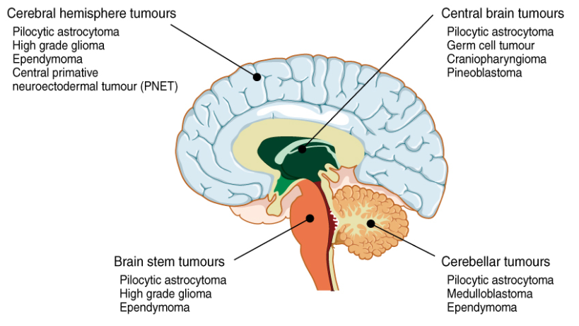
2. TYPES OF BRAIN TUMOURS
Astrocytomas: These develop in the cerebrum of the brain.
Oligodendroglial tumour: These occur in the brain’s frontal temporal lobes.
Glioblastomas: These are very aggressive tumour and develop in the supportive tissue of the brain

Slide 18
3. WHAT ARE THE POSSIBLE CAUSES AND RISK FACTORS OF BRAIN TUMOURS?
Radiation: Exposure to radiation can be from ionizing radiation from radiation therapy, X-rays, and CT scans. It can also be from power lines, nuclear plants, mobile phones, and cell phone towers.
Obesity: Being overweight or obese increases your risk of developing certain kinds of brain tumours.
Family History: Although it is rare, some types of brain tumours can be genetically inherited. If a lot of people in your family have had brain tumours, your risk of developing the same increases.
Past Cancers: People who have had cancers like leukaemia as a child have a higher risk of developing brain tumours as an adult.
Age and Race: The risk of getting brain tumours becomes greater as your age increases. Race is also a factor – Caucasians are at a higher risk of developing brain tumours than Asians or Africans.
Exposure to Chemicals: Exposure to certain harmful chemicals in your living or work environment can put you at risk of developing a brain tumour.

Slide 19
SYMPTOMS OF BRAIN TUMOUR YOU NEED TO WATCH OUT FOR
The most common are:
Headaches
Blurred vision
Vomiting
Confusion
Memory loss
Seizures (Loss of consciousness)
Mood and behavioural changes
Unequal pupils or drooping eyelids
Loss of bowel or bladder control
Tremors in the hands
Changes in hearing, taste or smell
Drowsiness (Excess sleepiness)
Weakness on a part of the face or in a limb

Slide 20
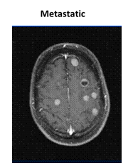
5. IMAGING - PRIMARY and METASTATIC
“Type” = the site of the primary cancer
Single or multiple tumors
Patients tend to receive treatment for metastatic
brain tumor by oncologist who treated primary site,
or a neuroncologist who specializes in brain tumors.

Slide 21
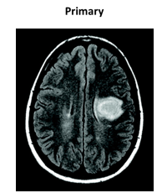
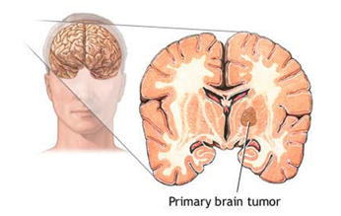
Begin in the brain
Over 100 types
“Type” = determined by cell type; classification changing to biologic differences
The biology provides clues as to why some people do better than others
Central Brain Tumor Registry of the United States (CBTRUS) tracks the
incidence of brain tumors

Slide 22
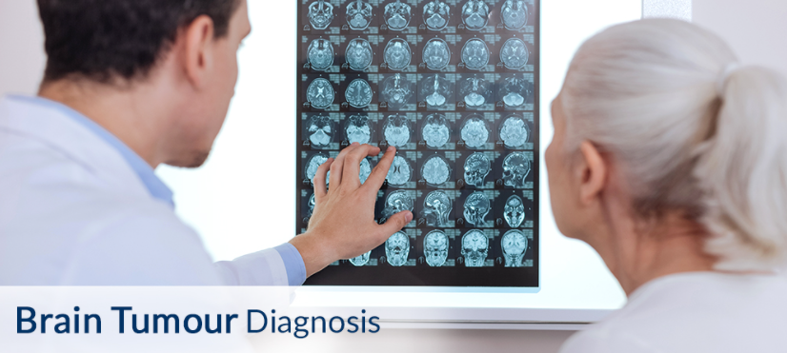
6. HOW TO DIAGNOSE A BRAIN TUMOUR?.

Slide 23
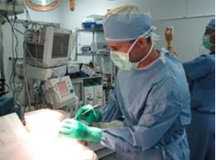
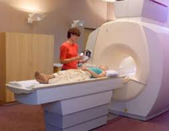
Skull X-Ray: Brain tumours can cause skull fractures, and an X-Ray can show us this. X-rays can also find calcium deposits that are found inside some brain tumours.
Imaging: Imaging tests like Magnetic Resonance Imaging (MRI), Computerised Tomography (CT) scan, and Positron Emission Tomography (PET) scan are used to diagnose brain tumours.

Slide 24
Neurological examination: This will include checking your hearing, balance, vision, coordination, reflexes, and strength. Difficulties in these areas are indicators that a specific part of your brain may be affected by a brain tumour.
Biopsy: A tiny piece of the tumour is removed through a minimally invasive surgery and then examined to determine whether it is benign or malignant.
Analysis of CSF: Cerebrospinal fluid is a colourless fluid present inside the spinal cord and brain. This fluid is tested to diagnose conditions like brain tumours.
Angiography: In this procedure, a fluorescent dye is injected into your bloodstream. The dye travels to the brain and lets the doctors see details about the blood supply to the tumour. This will be helpful during surgical removal of the tumour.

Slide 25
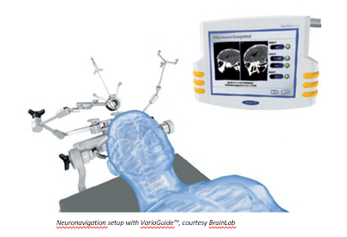
7. TYPES OF TREATMENTS AVAILABLE

Slide 26
Surgery: This is the most common treatment for malignant brain tumours. The surgeon removes as much of the cancerous cells as possible without damaging healthy brain tissue. Bleeding and infection are 2 possible side-effects of surgery. Benign brain tumours can also be removed through surgery.
Minimally Invasive Surgery: Neurosurgeons use minimally invasive techniques for this brain tumour surgery to remove the cancerous cells. This technique reduces your hospital stay duration, decreases your recovery time, and lowers the mortality rate.
Radiation Therapy: In this type of brain tumour treatment, radiation like X-rays or protons beams are used to kill tumour cells. This can be done by external beam radiation, where you sit in front of a machine and wear a protective covering, leaving only the tumour area exposed. This therapy can also be done via brachytherapy - a device is placed inside your body near the brain tumour that gives out radiation to kill the tumour cells. Side-effects of this therapy include fatigue, memory loss, headaches, and scalp irritation.

Slide 27
Chemotherapy: Drugs are injected or taken orally and they target and kill the tumour cells. Chemotherapy causes side effects like hair loss, vomiting, nausea, and tiredness.
Targeted Drug Therapy: Certain types of brain tumours are treated with drugs that target specific abnormalities that are present in the tumour cells by blocking them. This causes cancerous cells to die.
Radiosurgery: Unlike surgery in the traditional sense of the word, this treatment method is where many beams of radiation are focused onto the brain tumour to kill the tumour cells. Various technologies like linear accelerator and gamma knife are used to treat the brain tumour with radiation.

Slide 28
8. UNDERSTANDING RISKS ASSOCIATED WITH BRAIN TUMOUR SURGERY
Brain surgery is a complicated and serious process. It is the main treatment option for brain tumours. Advanced medical technology these days allows surgeons to operate. However, brain surgery is a critical medical procedure and carries some extra risk. Complications during and after are rare, but they may occur. Here are the risks associated with brain tumour surgery:
Bleeding
Swelling
Blood clots
Memory loss
Seizures
Coma
Stroke
Allergic response to anaesthesia
Infection at the incision site or in the brain

Slide 29
9. RECOVERY AND AFTERCARE (DIET AND NUTRITION TO FOLLOW)
Your diet and nutrition have a significant impact on your recovery after brain tumour surgery. Eating healthy, nutritious food can help you heal faster and prevent complications like high blood sugar or constipation. Here are some tips that will help:
Have smaller and more frequent meals instead of 3 large meals a day.
Avoid hot, spicy food.
Avoid greasy and oily food, fried stuff, and sweets.
Remain upright for at least an hour after you eat.
Have water between meals to stay hydrated, but do not drink too much water while eating.
Initially, eat soft, easily digestible, bland foods.
Eat foods containing fibre, like fresh fruits and vegetables, and whole grains.
Avoid constipation-inducing foods, such as processed foods, dried fruits, red meat, too much dairy, and sweets.
Have lean protein like chicken, fish, nuts, tofu, and beans.

Slide 30
CONCLUSION
In this project we have automated the diagnosis procedure for the brain tumor detection by the use of image processing. Apart from several existing brain tumor segmentation and detection methodology are present for MRI of brain image our project has proved to provide an aver all accuracy by upto 97%.
All the steps for detecting brain tumor that have been discussed starting from MRI image acquisition ,pre-processing steps to successfully classification of the tumor using the two segmentation techniques is been done.
Pre-processing involves operations like wavelet based methods has been discussed. Quality enhancement and filtering are important because edge sharpening, enhancement, noise removal and undesirable background removal are improved the image quality as well as the detection procedure.
Among the different filtering technique, Gaussian filter suppressed the noise without blurring the edges and it is better outlier without reducing sharpness of the images. reduces the noise, enhance the image quality and computationally more efficient than other filtering methodology. After the image quality improvement and noise reduction discussed here, segmentation methodology for a brain tumor from MRI of brain image is been used.

Slide 31
Classification based segmentation segment tumor accurately and manufacture sensible results for big information set however undesirable behaviours can occur in case wherever a category is unrepresented in training data.
Clustered based segmentation performs is straight forward, quick and manufacture sensible results for non-noise image except for noise pictures it leads to serious inaccuracy within the segmentation .
In neural network based segmentation perform better on noise field and no need of assumption of any fundamental data allocation but learning process is one of the great disadvantages of it.
In spite of several dealing of problems, an automization of brain tumor segmentation using combination of threshold based and classification with SVM and SOM overcame the problems and gives effective and accurate results for brain tumor detection.
These classification methods are able to firstly detect weather there is tumor or not and if it is there then they are able to determine weather the tumor is benign or malignant type.

Slide 32
REFERENCE
Sijbers J et al (1998), “Estimation of the noise in magnitude MR images”, Magn Reson Imaging 16(1):87–90.
An S, An D (1984) Stochastic relaxation, Gibbs distributions, and the Bayesian restoration of images. IEEE Trans Pattern Anal Mach Intell 6:721–741
Nowak RD (1999) Wavelet-based Rician noise removal for magnetic resonance imaging. IEEE Trans Image Process 8(10):1408–1419.
[4].https://www.researchgate.net/deref/http%3A%2F%2Fdicom.nema.org%2Fmedical%2Fdi com%2Fcurrent%2Foutpu t%2Fchtml %2Fpart12%2Fchapter_K.html
National institute of biomedical imaging and bioengineering (https://www.nibib.nih.gov/scienceeducation/science-topics/magnetic-resonance-imagingmri).
Amrutha Ravi, “Medical Image Segmentation”, Computer Methods And Programs In Biomedicine 84 (2006) 63–65.

Slide 33
MathWorks(https://in.mathworks.com/help/wavelet/ug/lifting-method-for-constructingwavelets.html).
(URL-in.mathworks.com/products/matlab.html?s_tid=hp_ff_p_matlab)
Hava T.siegelmann,Vladimir Vapnik,David Horn ,AsaBen-Hur,”Support Vector Clustering”,Journal of Machine Learning Research 2(2001) 125-137.
Professor Teuvo Kohonen ,”Self-Organising Maps”,Springer series in Information Science,1995.
Swapnil R.Telrandhe,”segmentation methods for medical image analysis”,tesis no 1434,center for medical image science and visualization ,se-58185 linkoping ,Sweden.
Malathi Hong-Long , , “Segmentation C- Means Clustering With Spatial Information For Image Segmentation,” Computerized Medical Imaging And Graphics 30 (2006) 9–15.
Rajeshwari G tayade,Michel Crucian , “Unsupervised And Semi-Supervised Clustering: A Brief Survey,” Inria Rocquencourt, B.P. 105 78153 Le Chesnay Cedex, France. [
Lukas L. et Al. Brain Tumor Classification Based On Long Echo Proton Mrs Signals

Slide 34
THANK YOU

